Slide 1

DIVINE GRACE COLLEGE OF ARTS, SCIENCE AND TECHNOLOGY
(DGCAST) — GAROUA | GEOGRAPHY DEPARTMENT
UPPER SIXTH ARTS — POPULATION GEOGRAPHY — LESSON 12
The Demographic Transition Model
Mr KAMDEM EMMANUEL
Geography Teacher — PLEG
Academic Year 2026 / 2027
Notes:
Good morning, class. Today we study Lesson 12: The Demographic Transition Model.

Slide 2
GEOGRAPHY — UPPER SIXTH ARTS
CLASS INFO
Class, Chapter & Duration
Class | Upper Sixth Arts
Chapter | Module 4: Understanding and managing population dynamics across the world in general and Cameroon in particular
Duration | 2 periods (2 × 50 minutes)
2026 / 2027
DGCAST GAROUA — GEOGRAPHY DEPARTMENT
Mr KAMDEM E. | 2

Slide 3
GEOGRAPHY — UPPER SIXTH ARTS
IDENTIFICATION
Lesson Identification
Topic | Population Change over Time (Population Growth)
Sub-topic | Population Growth
Lesson | Lesson 12: The Demographic Transition Model
Notions / Concepts | Demographic transition model, stages, natural increase, Rostow's model.
Syllabus focus | Meaning; stages and their characteristics linked to Rostow's model; appraisal; application to Cameroon.
Competence | Learners are able to use the DTM to explain population change and apply it to Cameroon.
2026 / 2027
DGCAST GAROUA — GEOGRAPHY DEPARTMENT
Mr KAMDEM E. | 3

Slide 4
GEOGRAPHY — UPPER SIXTH ARTS
OBJECTIVES
Learning Objectives
By the end of the lesson, the learner should be able to:
Describe the five stages of the DTM.
Link the DTM to Rostow's stages of economic growth.
Appraise the model and apply it to Cameroon.
2026 / 2027
DGCAST GAROUA — GEOGRAPHY DEPARTMENT
Mr KAMDEM E. | 4

Slide 5
GEOGRAPHY — UPPER SIXTH ARTS
RECALL
Recall
Death rates fell before birth rates in LEDCs.
Natural increase = births − deaths.
2026 / 2027
DGCAST GAROUA — GEOGRAPHY DEPARTMENT
Mr KAMDEM E. | 5

Slide 6
GEOGRAPHY — UPPER SIXTH ARTS
REAL-LIFE SITUATION
Real-Life Situation
A demographer says, "Cameroon is where Europe was about 100 years ago." Learners ask whether all countries follow the same path.
2026 / 2027
DGCAST GAROUA — GEOGRAPHY DEPARTMENT
Mr KAMDEM E. | 6
Notes:
Read the situation slowly, twice.

Slide 7
GEOGRAPHY — UPPER SIXTH ARTS
REAL-LIFE SITUATION
Situation — Question 1
What is the problem in the situation?
2026 / 2027
DGCAST GAROUA — GEOGRAPHY DEPARTMENT
Mr KAMDEM E. | 7

Slide 8
GEOGRAPHY — UPPER SIXTH ARTS
REAL-LIFE SITUATION
Answer
Learners want to know if all countries follow the same demographic path.
2026 / 2027
DGCAST GAROUA — GEOGRAPHY DEPARTMENT
Mr KAMDEM E. | 8

Slide 9
GEOGRAPHY — UPPER SIXTH ARTS
REAL-LIFE SITUATION
Situation — Question 2
Which model describes this path?
2026 / 2027
DGCAST GAROUA — GEOGRAPHY DEPARTMENT
Mr KAMDEM E. | 9

Slide 10
GEOGRAPHY — UPPER SIXTH ARTS
REAL-LIFE SITUATION
Answer
The Demographic Transition Model.
2026 / 2027
DGCAST GAROUA — GEOGRAPHY DEPARTMENT
Mr KAMDEM E. | 10

Slide 11
GEOGRAPHY — UPPER SIXTH ARTS
REAL-LIFE SITUATION
Situation — Question 3
At which stage is Cameroon?
2026 / 2027
DGCAST GAROUA — GEOGRAPHY DEPARTMENT
Mr KAMDEM E. | 11

Slide 12
GEOGRAPHY — UPPER SIXTH ARTS
REAL-LIFE SITUATION
Possible Answer
Stage 3 (falling births, low deaths).
2026 / 2027
DGCAST GAROUA — GEOGRAPHY DEPARTMENT
Mr KAMDEM E. | 12

Slide 13
GEOGRAPHY — UPPER SIXTH ARTS
JUSTIFICATION
Justification of the Lesson
This lesson helps us to explain population change with a model and to see where Cameroon stands.
2026 / 2027
DGCAST GAROUA — GEOGRAPHY DEPARTMENT
Mr KAMDEM E. | 13

Slide 14
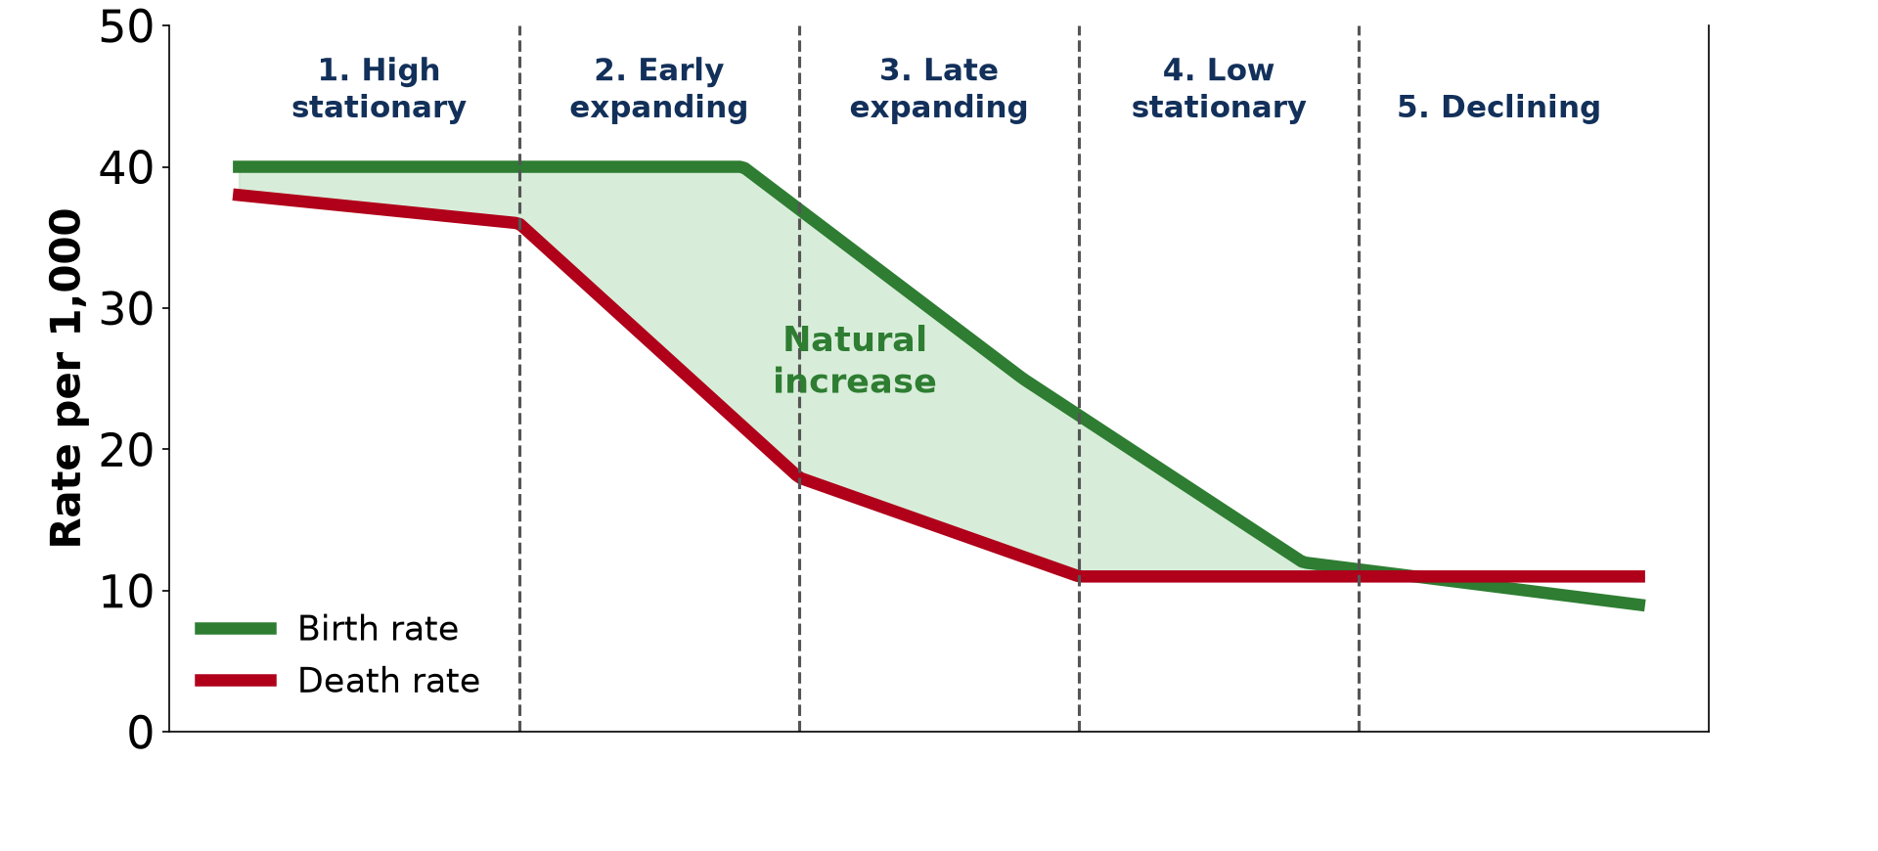
GEOGRAPHY — UPPER SIXTH ARTS
I. THE MODEL
Activity 1
The Demographic Transition Model.
2026 / 2027
DGCAST GAROUA — GEOGRAPHY DEPARTMENT
Mr KAMDEM E. | 14
Notes:
Without the projector: draw the two lines.

Slide 15
GEOGRAPHY — UPPER SIXTH ARTS
I. THE MODEL
Activity 1: Question
In which stage is natural increase highest?
2026 / 2027
DGCAST GAROUA — GEOGRAPHY DEPARTMENT
Mr KAMDEM E. | 15

Slide 16
GEOGRAPHY — UPPER SIXTH ARTS
I. THE MODEL
Answer
In stage 2 (early expanding).
2026 / 2027
DGCAST GAROUA — GEOGRAPHY DEPARTMENT
Mr KAMDEM E. | 16

Slide 17
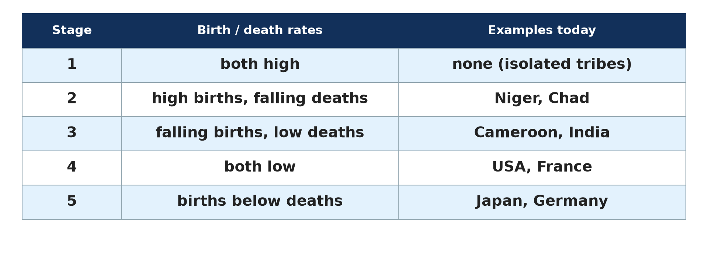
GEOGRAPHY — UPPER SIXTH ARTS
II. STAGES TODAY
Activity 2
Countries at each stage.
2026 / 2027
DGCAST GAROUA — GEOGRAPHY DEPARTMENT
Mr KAMDEM E. | 17
Notes:
Without the projector: copy the table.

Slide 18
GEOGRAPHY — UPPER SIXTH ARTS
II. STAGES TODAY
Activity 2: Question
Why does stage 1 hardly exist today?
2026 / 2027
DGCAST GAROUA — GEOGRAPHY DEPARTMENT
Mr KAMDEM E. | 18

Slide 19
GEOGRAPHY — UPPER SIXTH ARTS
II. STAGES TODAY
Answer
Modern medicine has lowered death rates almost everywhere.
2026 / 2027
DGCAST GAROUA — GEOGRAPHY DEPARTMENT
Mr KAMDEM E. | 19

Slide 20
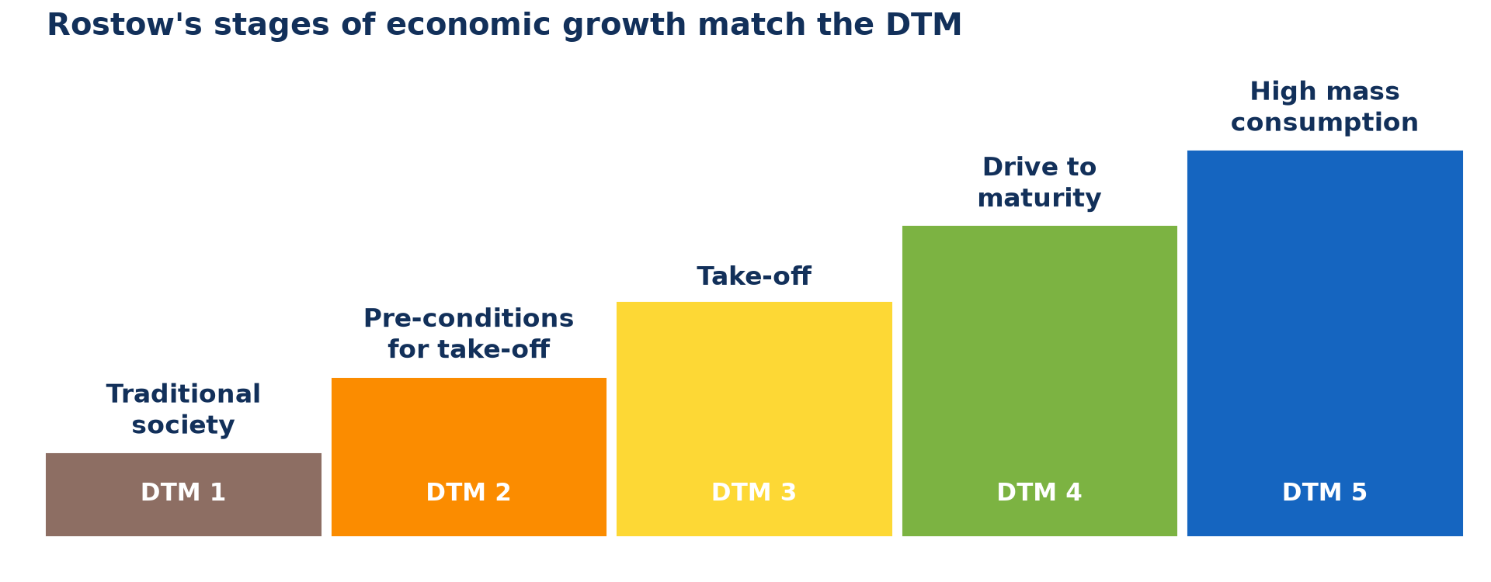
GEOGRAPHY — UPPER SIXTH ARTS
III. LINK WITH ROSTOW
Activity 3
Rostow's stages of economic growth.
2026 / 2027
DGCAST GAROUA — GEOGRAPHY DEPARTMENT
Mr KAMDEM E. | 20
Notes:
Without the projector: match the stages.

Slide 21
GEOGRAPHY — UPPER SIXTH ARTS
III. LINK WITH ROSTOW
Activity 3: Question
Which Rostow stage matches stage 4 of the DTM?
2026 / 2027
DGCAST GAROUA — GEOGRAPHY DEPARTMENT
Mr KAMDEM E. | 21

Slide 22
GEOGRAPHY — UPPER SIXTH ARTS
III. LINK WITH ROSTOW
Answer
The drive to maturity.
2026 / 2027
DGCAST GAROUA — GEOGRAPHY DEPARTMENT
Mr KAMDEM E. | 22

Slide 23
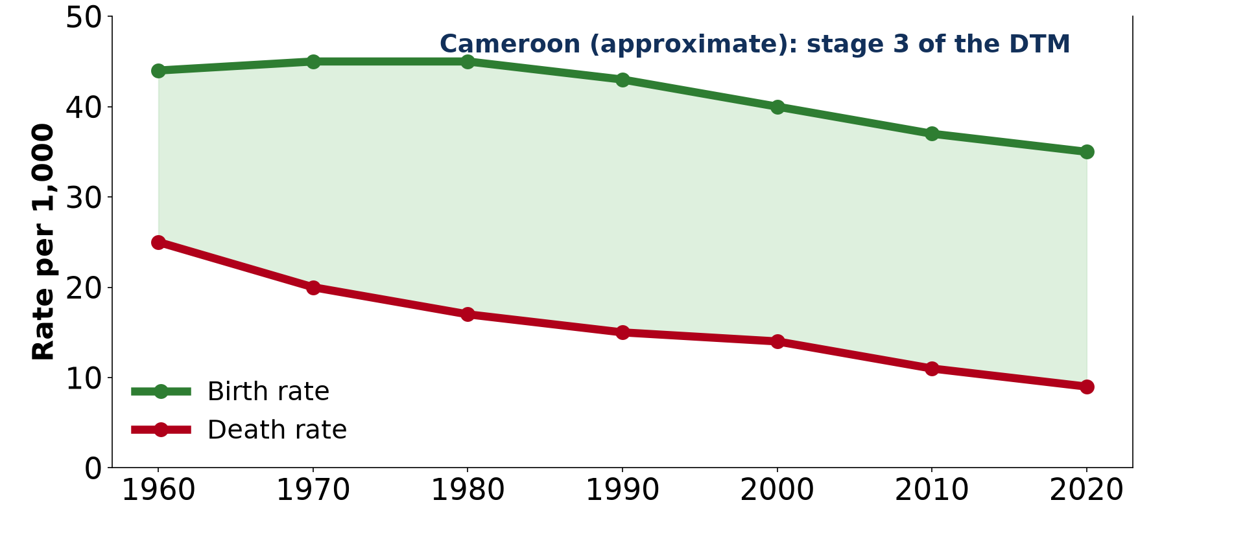
GEOGRAPHY — UPPER SIXTH ARTS
IV. CAMEROON
Activity 4
Birth and death rates of Cameroon (approximate).
2026 / 2027
DGCAST GAROUA — GEOGRAPHY DEPARTMENT
Mr KAMDEM E. | 23
Notes:
Without the projector: read the graph.

Slide 24
GEOGRAPHY — UPPER SIXTH ARTS
IV. CAMEROON
Activity 4: Question
Why is Cameroon in stage 3?
2026 / 2027
DGCAST GAROUA — GEOGRAPHY DEPARTMENT
Mr KAMDEM E. | 24

Slide 25
GEOGRAPHY — UPPER SIXTH ARTS
IV. CAMEROON
Answer
Death rates are low and birth rates are starting to fall.
2026 / 2027
DGCAST GAROUA — GEOGRAPHY DEPARTMENT
Mr KAMDEM E. | 25

Slide 26

GEOGRAPHY — UPPER SIXTH ARTS
V. APPRAISAL
Activity 5
Girls at school.
2026 / 2027
DGCAST GAROUA — GEOGRAPHY DEPARTMENT
Mr KAMDEM E. | 26
Notes:
Without the projector: discuss the weaknesses.

Slide 27
GEOGRAPHY — UPPER SIXTH ARTS
V. APPRAISAL
Activity 5: Question
Give one weakness of the DTM.
2026 / 2027
DGCAST GAROUA — GEOGRAPHY DEPARTMENT
Mr KAMDEM E. | 27

Slide 28
GEOGRAPHY — UPPER SIXTH ARTS
V. APPRAISAL
Answer
It is based on Europe and may not fit all countries; it ignores migration.
2026 / 2027
DGCAST GAROUA — GEOGRAPHY DEPARTMENT
Mr KAMDEM E. | 28

Slide 29
GEOGRAPHY — UPPER SIXTH ARTS
BOARD SUMMARY
The Demographic Transition Model
Topic: Population Change over Time (Population Growth)
Sub-topic: Population Growth
Lesson 12: The Demographic Transition Model
2026 / 2027
DGCAST GAROUA — GEOGRAPHY DEPARTMENT
Mr KAMDEM E. | 29
Notes:
Learners copy the board summary now. Give them enough time for each slide.

Slide 30
GEOGRAPHY — UPPER SIXTH ARTS
BOARD SUMMARY
I. Definitions
Demographic Transition Model: It is a model that shows how birth and death rates change as a country develops.
Natural increase: It is the gap between birth and death rates.
2026 / 2027
DGCAST GAROUA — GEOGRAPHY DEPARTMENT
Mr KAMDEM E. | 30

Slide 31
GEOGRAPHY — UPPER SIXTH ARTS
BOARD SUMMARY
II. The Stages (1/2)
A. Stages 1 and 2: In stage 1 both rates are high and growth is slow. In stage 2 death rates fall fast and growth is rapid.
B. Stage 3: Birth rates fall because of education, towns and family planning. Growth slows but is still high.
2026 / 2027
DGCAST GAROUA — GEOGRAPHY DEPARTMENT
Mr KAMDEM E. | 31

Slide 32
GEOGRAPHY — UPPER SIXTH ARTS
BOARD SUMMARY
II. The Stages (2/2)
C. Stages 4 and 5: In stage 4 both rates are low and growth is slow. In stage 5 births fall below deaths and population declines.
D. Link with Rostow: The stages match Rostow's traditional society, take-off and maturity. Economic growth and demographic change go together.
2026 / 2027
DGCAST GAROUA — GEOGRAPHY DEPARTMENT
Mr KAMDEM E. | 32

Slide 33
GEOGRAPHY — UPPER SIXTH ARTS
BOARD SUMMARY
III. Appraisal and Cameroon (1/3)
A. Strengths: The model is simple and fits the history of Europe. It helps to predict change.
B. Weaknesses: It is based on Europe and ignores migration. Some LEDCs change faster, and stage 5 was not in the original model.
2026 / 2027
DGCAST GAROUA — GEOGRAPHY DEPARTMENT
Mr KAMDEM E. | 33

Slide 34
GEOGRAPHY — UPPER SIXTH ARTS
BOARD SUMMARY
III. Appraisal and Cameroon (2/3)
C. Cameroon: Cameroon is in stage 3, with a death rate near 9 and a birth rate near 35 per 1,000. Faster female education could speed up the transition.
2026 / 2027
DGCAST GAROUA — GEOGRAPHY DEPARTMENT
Mr KAMDEM E. | 34

Slide 35
GEOGRAPHY — UPPER SIXTH ARTS
BOARD SUMMARY
III. Appraisal and Cameroon (3/3)
Copy the DTM.
2026 / 2027
DGCAST GAROUA — GEOGRAPHY DEPARTMENT
Mr KAMDEM E. | 35

Slide 36
GEOGRAPHY — UPPER SIXTH ARTS
FORMATIVE EVALUATION
Formative Evaluation 1
Describe stage 2 of the DTM.
2026 / 2027
DGCAST GAROUA — GEOGRAPHY DEPARTMENT
Mr KAMDEM E. | 36

Slide 37
GEOGRAPHY — UPPER SIXTH ARTS
FORMATIVE EVALUATION
Expected Answer
Death rates fall fast while birth rates stay high; rapid growth.
2026 / 2027
DGCAST GAROUA — GEOGRAPHY DEPARTMENT
Mr KAMDEM E. | 37

Slide 38
GEOGRAPHY — UPPER SIXTH ARTS
FORMATIVE EVALUATION
Formative Evaluation 2
Give two weaknesses of the DTM.
2026 / 2027
DGCAST GAROUA — GEOGRAPHY DEPARTMENT
Mr KAMDEM E. | 38

Slide 39
GEOGRAPHY — UPPER SIXTH ARTS
FORMATIVE EVALUATION
Expected Answer
Based on Europe; ignores migration (also timing differs, stage 5 not in original).
2026 / 2027
DGCAST GAROUA — GEOGRAPHY DEPARTMENT
Mr KAMDEM E. | 39

Slide 40
GEOGRAPHY — UPPER SIXTH ARTS
REMEDIATION
Remediation
Fill in the blanks:
The fastest growth is in stage ______.
Cameroon is in stage ______.
Japan is in stage ______.
2026 / 2027
DGCAST GAROUA — GEOGRAPHY DEPARTMENT
Mr KAMDEM E. | 40
Notes:
Answers: 1. 2 2. 3 3. 5

Slide 41
GEOGRAPHY — UPPER SIXTH ARTS
HOMEWORK
Homework
Draw the DTM and place Niger, Cameroon, France and Japan on it.
This prepares Lesson 13: Migration.
2026 / 2027
DGCAST GAROUA — GEOGRAPHY DEPARTMENT
Mr KAMDEM E. | 41
Notes:
This homework prepares the next lesson.

Slide 42
GEOGRAPHY — UPPER SIXTH ARTS
BILINGUAL GAME
Bilingual Game (Jeu Bilingue)
English | Français
Model | Le modèle
Stage | Le stade
Transition | La transition
Birth rate | Le taux de natalité
Development | Le développement
Appraisal | L'évaluation
2026 / 2027
DGCAST GAROUA — GEOGRAPHY DEPARTMENT
Mr KAMDEM E. | 42
Notes:
Say the English word; learners give the French word, then the reverse.

Slide 43
GEOGRAPHY — UPPER SIXTH ARTS
LOGBOOK
Official Logbook (1/2)
Module / Topic | Population Change over Time (Population Growth)
Lesson Title | Lesson 12: The Demographic Transition Model
Expected Learning Outcomes | Describe the five stages of the DTM. Link the DTM to Rostow's stages of economic growth. Appraise the model and apply it to Cameroon.
Competence | Learners are able to use the DTM to explain population change and apply it to Cameroon.
2026 / 2027
DGCAST GAROUA — GEOGRAPHY DEPARTMENT
Mr KAMDEM E. | 43

Slide 44
GEOGRAPHY — UPPER SIXTH ARTS
LOGBOOK
Official Logbook (2/2)
Matter Taught | I. Definitions: Demographic Transition Model, Natural increase; II. The Stages: Stages 1 and 2, Stage 3, Stages 4 and 5, Link with Rostow; III. Appraisal and Cameroon: Strengths, Weaknesses, Cameroon.
Evaluation | Formative evaluation (3 questions) and remediation exercise.
Homework | Draw the DTM and place Niger, Cameroon, France and Japan on it.
Enrolment / Present / Absent | ____ / ____ / ____
Achievement | To be completed by the teacher after the lesson.
2026 / 2027
DGCAST GAROUA — GEOGRAPHY DEPARTMENT
Mr KAMDEM E. | 44

Slide 45
GEOGRAPHY — UPPER SIXTH ARTS
TEACHER'S NOTE
Teacher's Note
Timing: Set-up, recall 8 min | Situation 8 min | 5 activities 30 min | Board summary (copying) 30 min | Evaluation, remediation 10 min | Homework, logbook 9 min | Spare 5 min
2026 / 2027
DGCAST GAROUA — GEOGRAPHY DEPARTMENT
Mr KAMDEM E. | 45

Slide 46
GEOGRAPHY — UPPER SIXTH ARTS
REFERENCES
References
National Geography Syllabus, Sixth Forms (Lower & Upper Sixth), MINESEC/IGE/IP-SS, August 2019 — Module 4 (Population Geography).
Photo, Activity 5: “Students in Primary Seven at Zanaki Primary School” by World Bank Photo Collection, CC BY-NC-ND 2.0, via Flickr (https://www.flickr.com/photos/10816734@N03/33423887921)
Diagrams and animations: drawn for this lesson (DGCAST Geography Department).
2026 / 2027
DGCAST GAROUA — GEOGRAPHY DEPARTMENT
Mr KAMDEM E. | 46

